Slide 1
Brief Intro to LLVM Backend
Shi Ningning/史宁宁

Slide 2
Contents
About Me
Overview of LLVM Backend
Important Steps of Backend
The Special Backends in History

Slide 3
About Me

Slide 4


About Me
CSDN ID:snsn1984

Slide 5
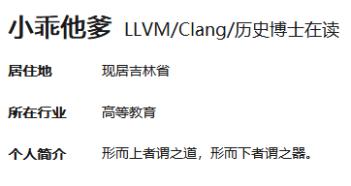
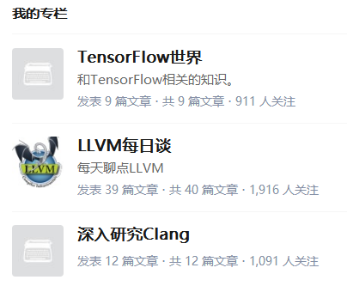
About Me
Zhihu ID：小乖他爹

Slide 6
Overview of LLVM Backend

Slide 7
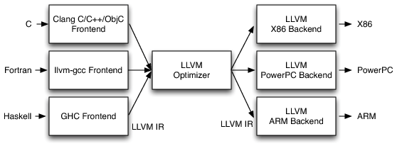
LLVM's Implementation of the Three-Phase Design
Notes：From LLVM DOC：《Intro to LLVM:Book chapter providing a compiler hacker’s introduction to LLVM》

Slide 8
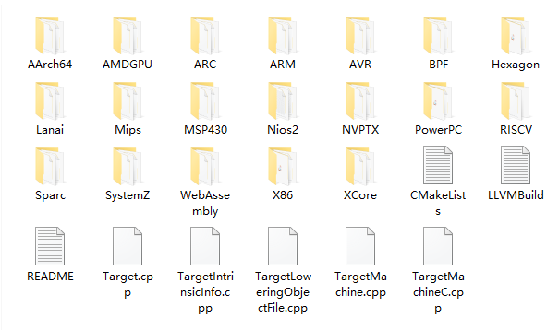
The Backends in LLVM6.0.0
Notes：This is the source code dir of LLVM6.0.0，its location is LLVM/lib/Target/.

Slide 9
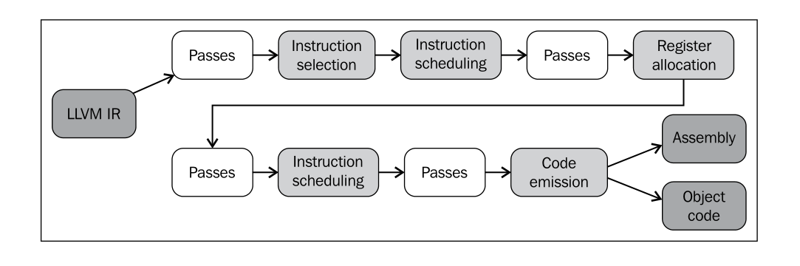
The Steps in LLVM Backend
Notes: 《Getting Started with LLVM Core Libraries》P134.

Slide 10
The Steps in LLVM Backend（Another version）
SDFSDFFSDF
SSA-based Machine Code Optimizations
Instruction Selection
Scheduling and Formation
Register
Allocation
Prolog/Epilog Code Insertion
Late Machine Code Optimizations
Code
Emission
Notes：According the LLVM DOC《The LLVM Target-Independent Code Generator》.
Notes:
Prolog/Epilog Code Insertion: This stage is responsible for implementing optimizations like frame-pointer elimination and stack packing.

Slide 11
The Steps in LLVM Backend

Slide 12
The Steps in LLVM Backend

Slide 13
The Steps in LLVM Backend
Notes:
The scheduling phase takes the DAG of target instructions from the selection phase and assigns an order. The scheduler can pick an order depending on various constrains of the machines(i.e. order for minimal register pressure or try to cover instruction latencies). Once an order is established, the DAG is converted to a list of MachineInstrs and the SelectionDAG is destroyed.

Slide 14
The Important Steps in LLVM Backend

Slide 15
Important Steps of Backend

Slide 16
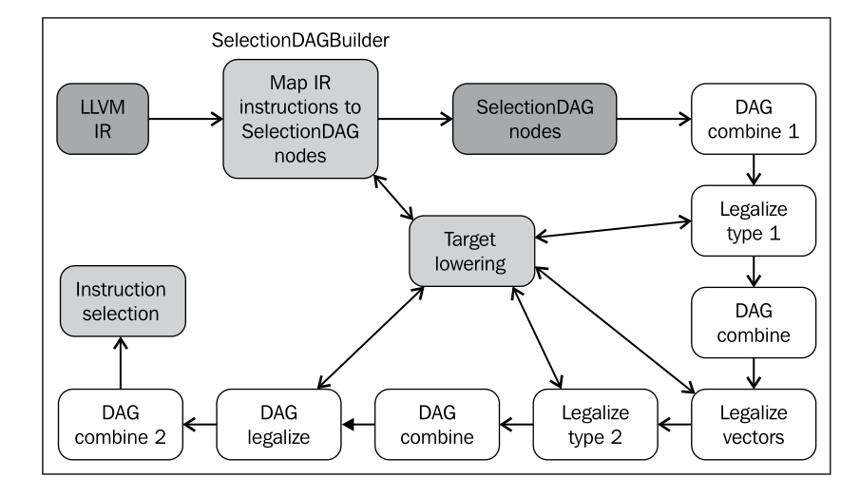
Instruction selection
Notes：《Getting Started with LLVM Core Libraries》P150
Notes:
Target lowering

Slide 17
Instruction selection
The TargetLowering class is used by SelectionDAG based instruction selectors primarily to describe how LLVM code should be lowered to SelectionDAG operations. Among other things, this class indicate: which operations are natively supported by the target machine.
The DAG combine pass optimizes suboptimal SelectionDAG constructions by matching a set of nodes and replacing them with a simpler construct whenever it is profitable.
The type legalization pass guarantees that instruction selection only needs to deal with legal types. Legal types are the ones natively supported by the target.
Notes:
Target lowering

Slide 18
Instruction selection
The SelectionDAG class employs a DAG to represent the computation of each basic block, and each SDNode corresponds to an instruction or operand.
The primary payload of the SDNode is its operation code (Opcode) that indicates what operation the node performs and the operands to the operation. The various operation node types are described at the top of the include/llvm/CodeGen/IDSOpcodes.h file.
The SelectionDAG optimization phase(DAG Combiner) is run multiple times for code generation, immediately after the DAG is built and once after each legalization. The first run of the pass allows the initial code to be cleaned up. Subsequent runs of the pass clean up the messy code generated by the Legalize passes, which allows Legalize to be very simple.
Notes:
1、Getting P148 Notes: The SelectionDAG is a Directed-Acyclic-Graph whose nodes are instances of the SDNode class.(LLVM DOC)

Slide 19
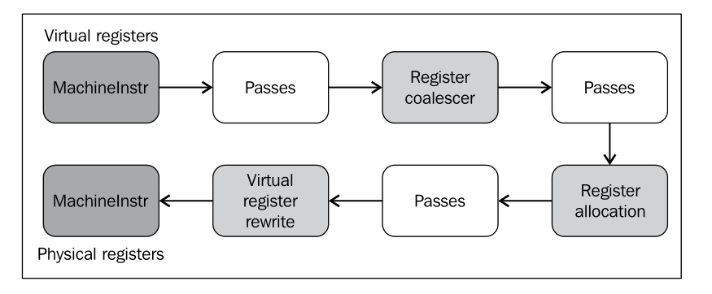
Register Allocation
Notes：《Getting Started with LLVM Core Libraries》P162

Slide 20
Register Allocation
The register coalesce removes redundant copy instructions(COPY) by joining intervals.
The register allocation pass selects the physical registers to be used for each virtual one. VirRegMap holds the result from register allocation, containing a map from virtual to physical registers.
The virtual register rewrite pass uses VirRegMap and replace virtual register references with physical ones.

Slide 21
Register Allocation
In LLVM, physical registers are denoted by integer numbers that normally range from 1 to 1023.
Some architectures contain registers that share the same physical location. These physical registers are marked as aliased in LLVM.
Each virtual register can only be mapped to physical registers of a particular class.
If the number of physical registers is not enough to accommodate all the virtual registers, some of them will have to be mapped into memory. These virtuals are called spilled virtuals.

Slide 22
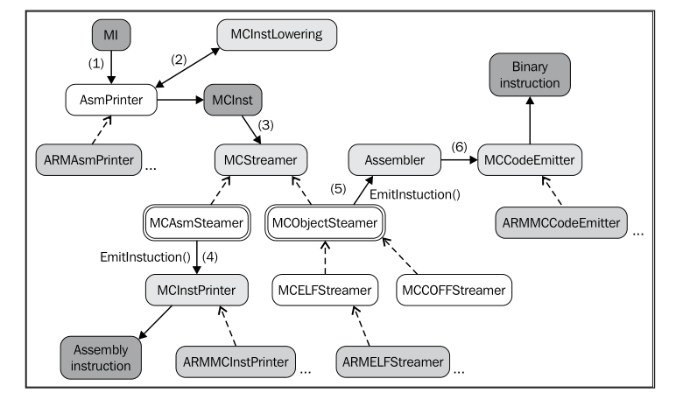
Code Emission
Notes：《Getting Started with LLVM Core Libraries》P170

Slide 23
Code Emission
MachineInstr is an extremely abstract way of representing machine instructions. In particular, it only keeps track of an opcode number and a set of operands.
MCInst is a simple class(much more so than MachineInstr) that holds a target-specific opcode and a vector of MCOperands.
AsmPrinter is a machine function pass that first emits the function header and then iterates over all basic block, dispatching one MI instruction at a time to the EmitInstruction() method for further processing.
Notes:
MachineInstr
The opcode number is simple unsigned integer that only has meaning to a specific backend. The operands of a machine instruction can be of several different types: a register reference, a constant integer, a basic block reference, etc.

Slide 24
Code Emission
The MCStreamer class processes a stream of MCInst instructions to emit them to the chosen output via two subclasses: MCAsmStreamer and MCObjectStreamer.
Notes:
MachineInstr
The opcode number is simple unsigned integer that only has meaning to a specific backend. The operands of a machine instruction can be of several different types: a register reference, a constant integer, a basic block reference, etc.

Slide 25
The Special Backends in History

Slide 26
The Special Backends in History
CBackend (LLVM3.0)
CPPBackend (LLVM 3.8)
The C backend does not require register allocation, instruction selection, or any of the other standard components provided by the system. As such, it only implements these two interfaces ( TargetMachine and DataLayout ), and does its own thing. Note that C backend was removed from the trunk since LLVM 3.1 release. ——《The LLVM Target-Independent Code Generator》
Notes：The screen shots from http://llvm.org/viewvc/llvm-project/.
Notes:
For example, the C backend does not require register allocation, instruction selection, or any of the other standard components provided by the system. As such, it only implements these two interfaces( TargetMachine and DataLayout ), and does its own thing. Note that C backend was removed from the trunk since LLVM 3.1 release. ——《The LLVM Target-Independent Code Generator》

Slide 27
The Special Backends in History
LLVMTargetMachine is designed as a base class for targets implemented with the LLVM target-independent code generator. LLVMTargetMachine is defined as a subclass of a TargetMachine in include/llvm/Target/TargetMachine.h.
The DataLayout class is the only required target description class. DataLayout specifies information about how the target lays out memory for structures, the alignment requirements for various data types, the size of pointers in the target, and whether the target is little-endian or big-endian.

Slide 28
Thanks!
2018-7-28

